Slide 1
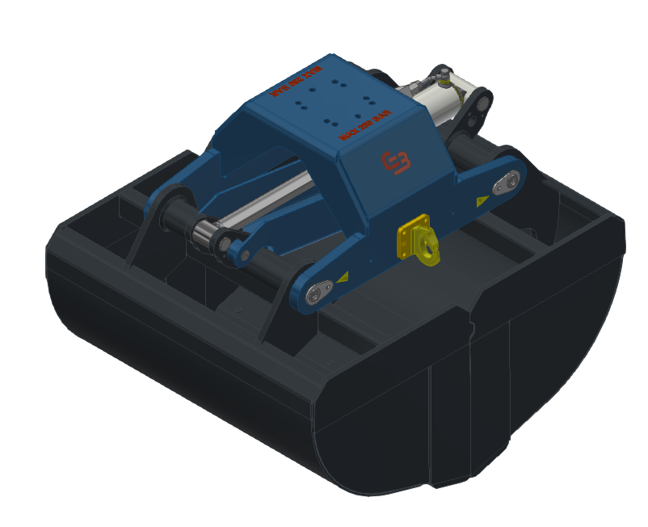

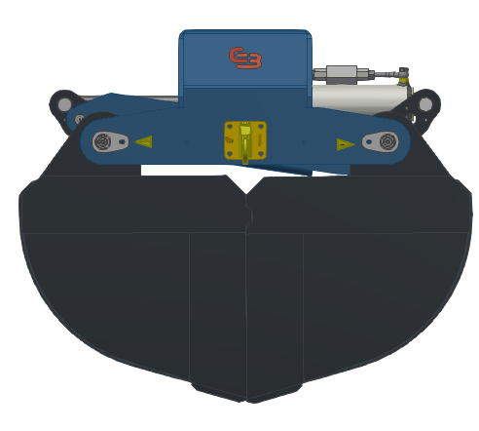
GB BE/UK
09-06-2026

Slide 2

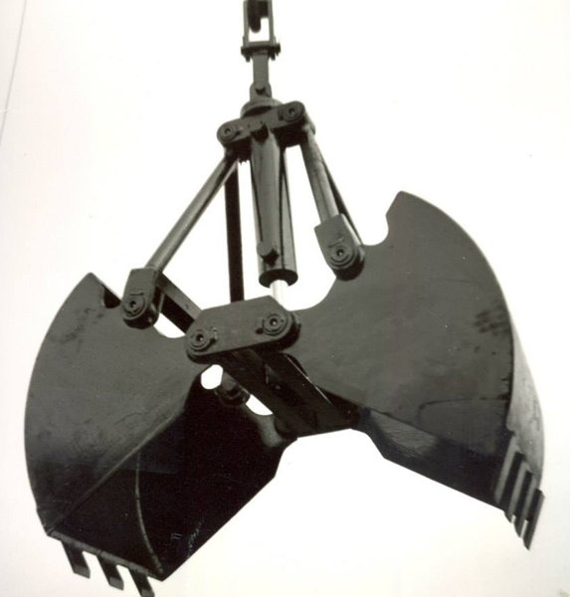
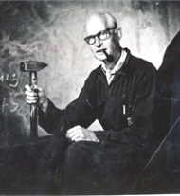
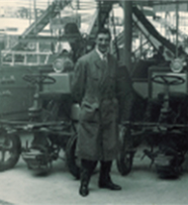

History
85 YEARS OF EXPERIENCE
Established in 1939, headquartered in The Netherlands, EU. Dedicated to attachment manufacturing since the 1950’s.
The manufacturer of attachments for truck cranes and excavators since the merger of Bakker-Hydraulics & Gusella in 2014.
Gusella Equipment
First Clamshell Grab
with vertical cylinders
GEJO container emptying
system was developed
Consolidation phase
Bakker Hydraulic & Gusella
Participation by
Anders Invest
The company transition
to “Gusella-Bakker”
Bakker Hydraulic Products
1939
1950
1969
1989
2016
2023
2024
1959
2014
First Orange Peel
Grab developed by Gusella
Gusella Equipment joins
Bakker Hydraulic & merge

Slide 3
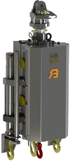
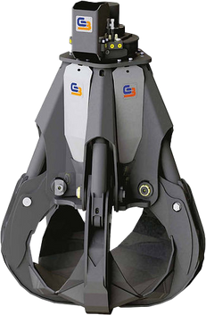
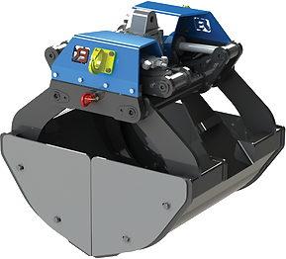
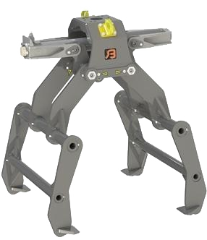
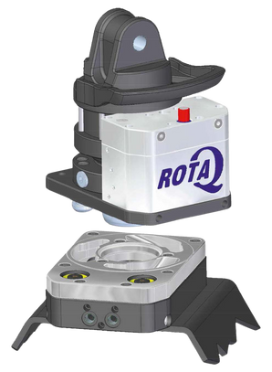
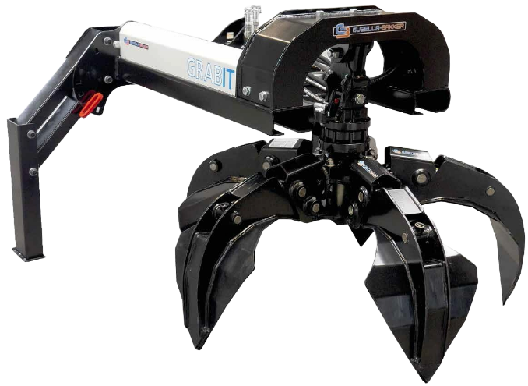
Products
A DEDICATED ATTACHMENT SUPPLIER
Clamshell
Grabs
Container
Emptying
Systems
Orange Peel
Grabs
Plate
Clamps
Rotators
and
quickcoupling
systems
Grab-It Forklift
Attachments

Slide 4
Advantages
HIGHEST QUALITY & COMPETITIVE ATTACHMENTS
Our grabs are built to last! Only using quality metals like Hardox 400 and S500 steel.
Better by design, for operational longevity and cost reduction.
Automated welding process that guarantees the best quality and consistency.
We manufacture over 2000 attachments per year.
Orange Peel
Grabs
RESULT
Our products are engineered to the best, last the longest and reduce operational cost

Slide 5
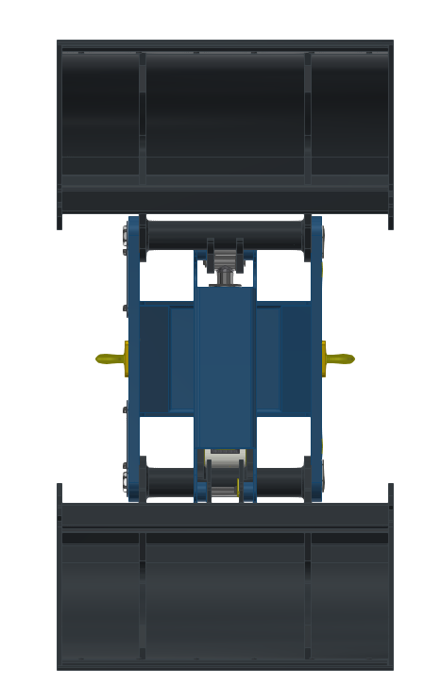
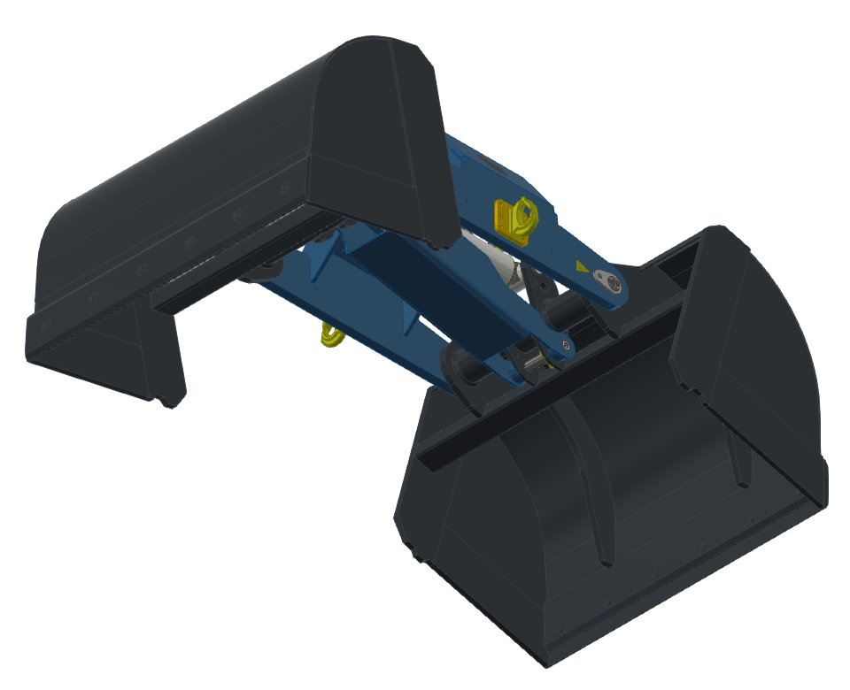
General construction
Bridge:
  Welded construction
  Load hooks at the sides
  Standard ø90mm hydraulic cylinder
  Reaction arm also functions as guard for the cylinder

Slide 6
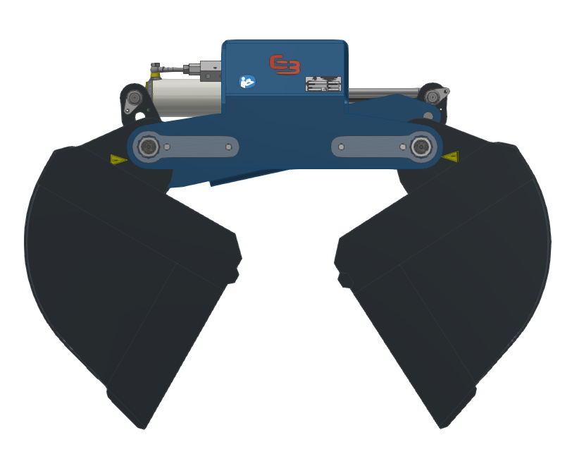
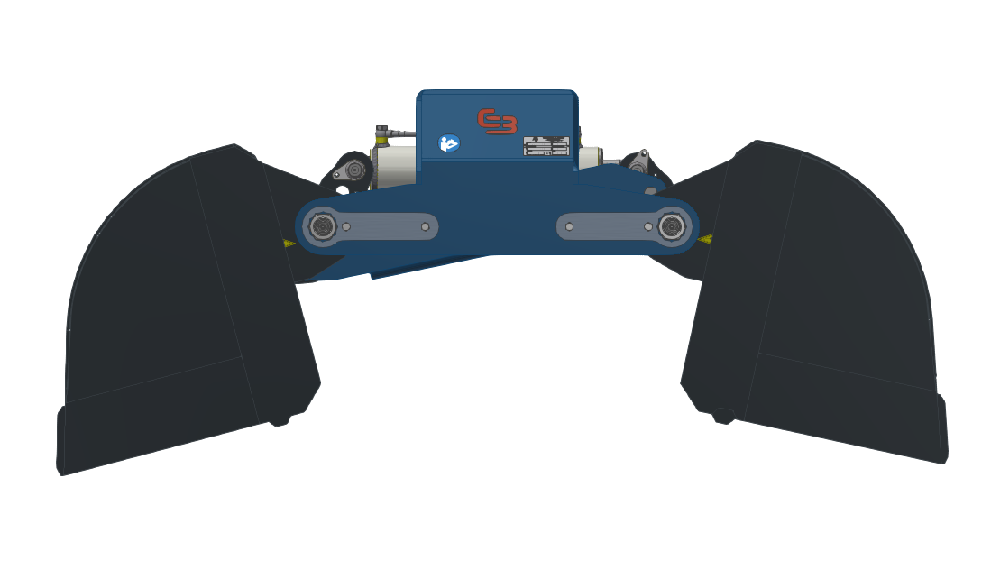
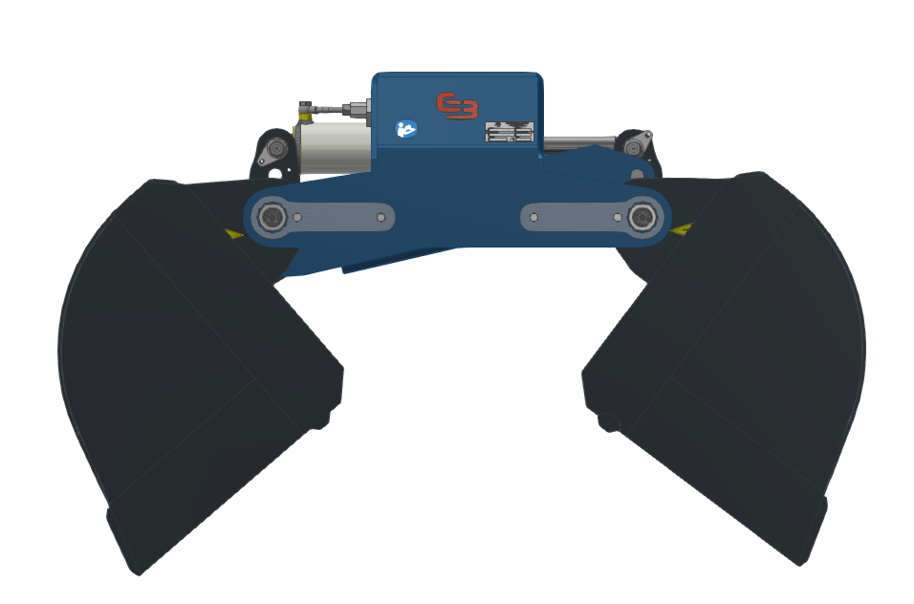
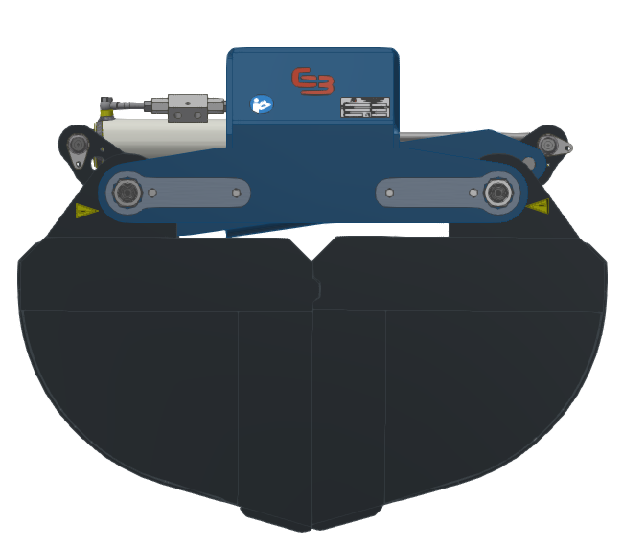
Range of grippers
No leftovers! The gripper operates in a 90 degrees angle and cleans out the entire truck.

Slide 7
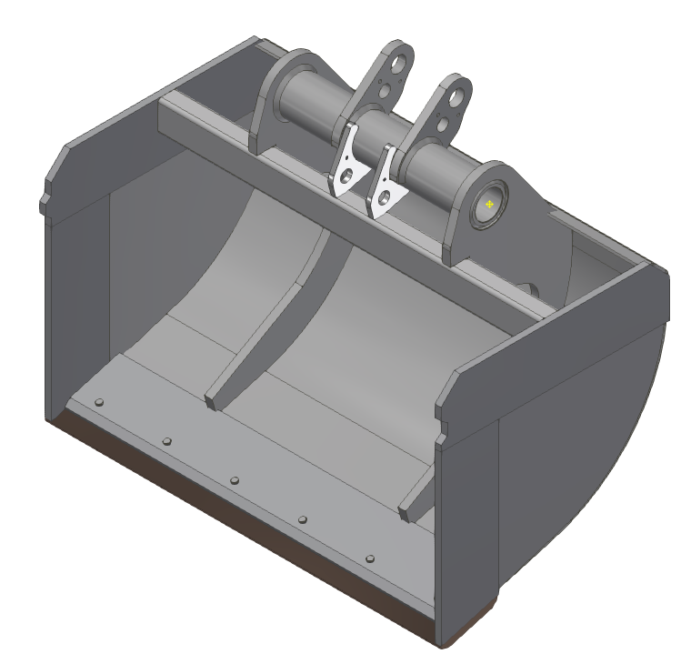
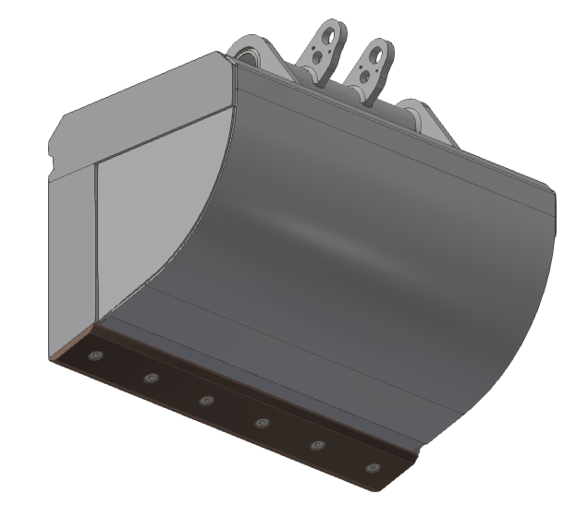
Concept for clamshell
Gripper clamshells:
  Equipped with two ribs
  Reinforced clamshell sides
  An intermediate tube to keep the side-plates rigid
  Exchangeable knife edge

Slide 8
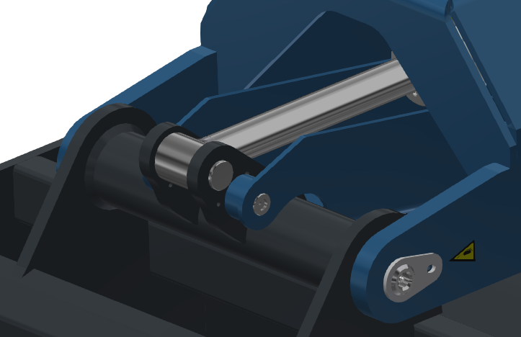
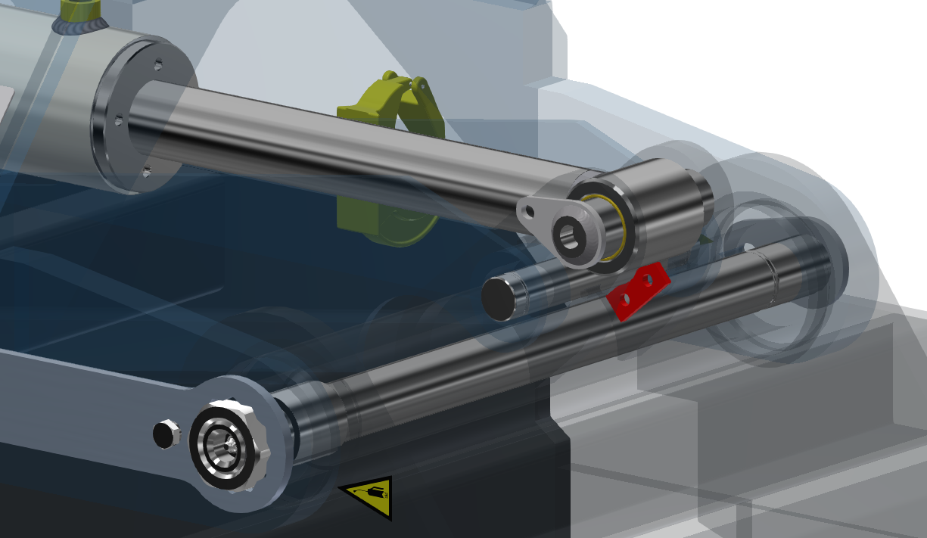
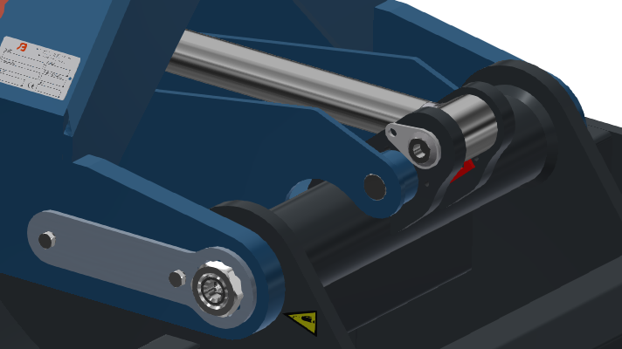
Concept for connection
Bridge/Clams connection:
Pins and bushes extend fully through the structure to manage torque effectively.
A steel plate is used to secure the connection, ensuring safety.

Slide 9
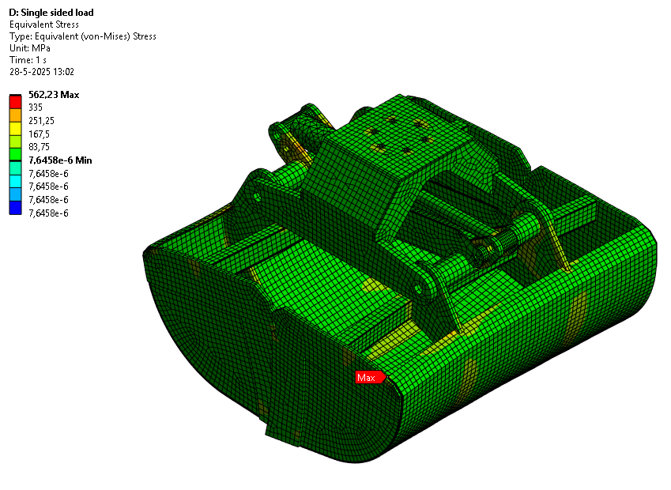
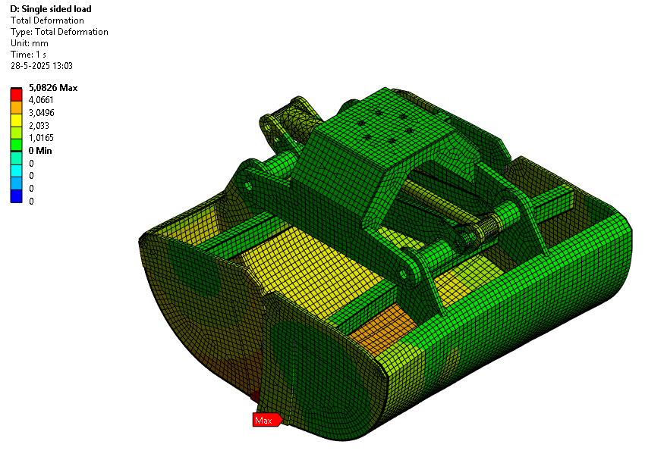
FEM Results 260 BAR
Max deformation at clamshell side where they are not connected (the halves can move into eachother)
Displayed in 22x exaggerated scale

Slide 10
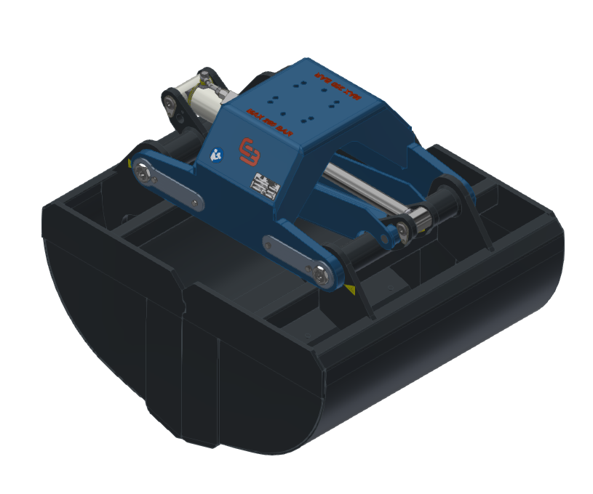
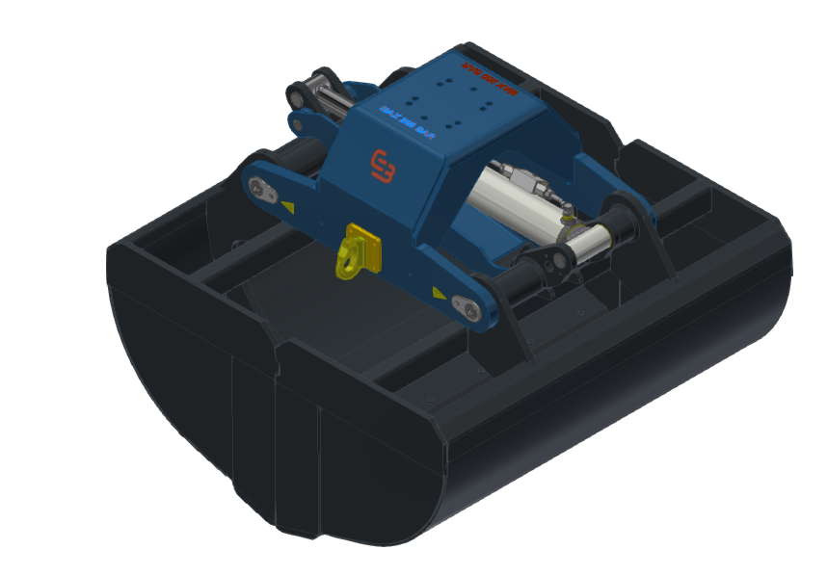
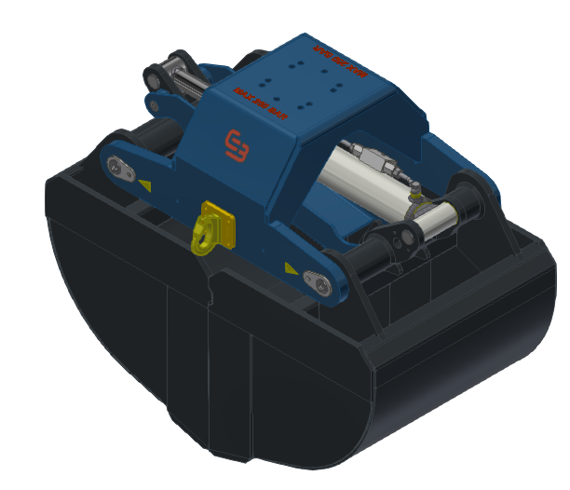
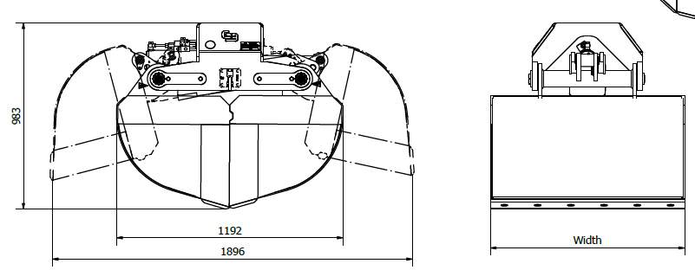
Variants
The GB BEUK gripper family will consist of the following gripper widths:
Here the 1200mm & 650mm are shown side by side
Width | Content
650 mm | 340 L
800 mm | 425 L
1000 mm | 530 L
1200 mm | 640 L

Slide 11
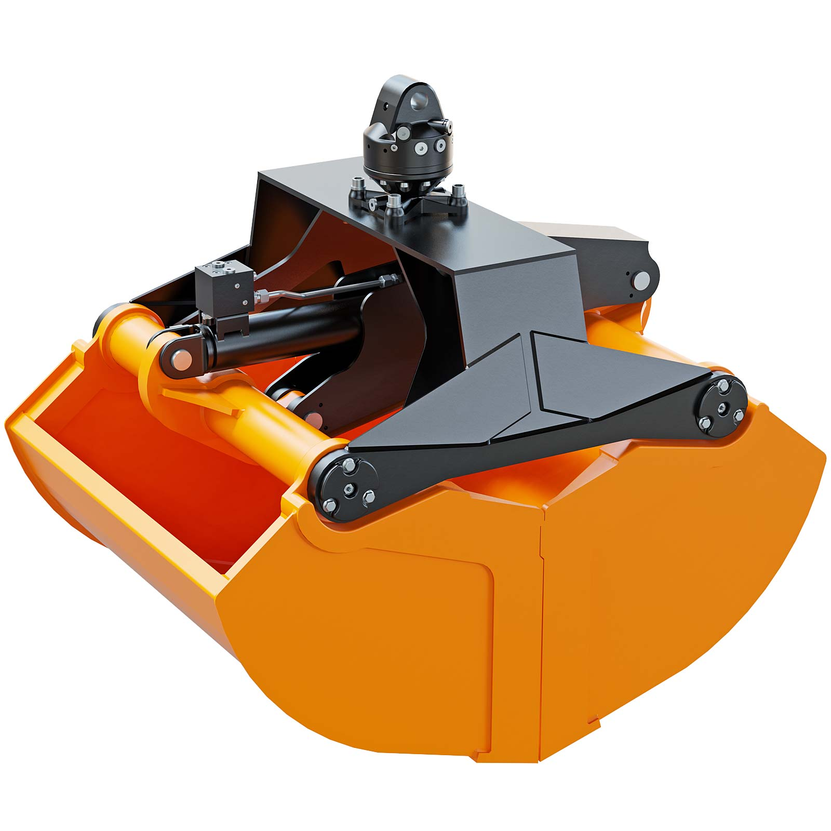

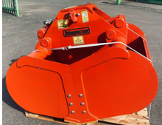
Advantages over main competitors
The GB Clamshell Bucket offers the following advantages:
- The hydraulic cylinder is protected by a steel plate to prevent damage from materials.
- Each shell includes two reinforcing ribs for increased stiffness and durability.
- The bridge and shells are connected with an iron pin to resist torsional forces.
- Capable of grabbing and digging with a force of 29 kN
- Capable of cleaning out the entire truck.

Slide 12
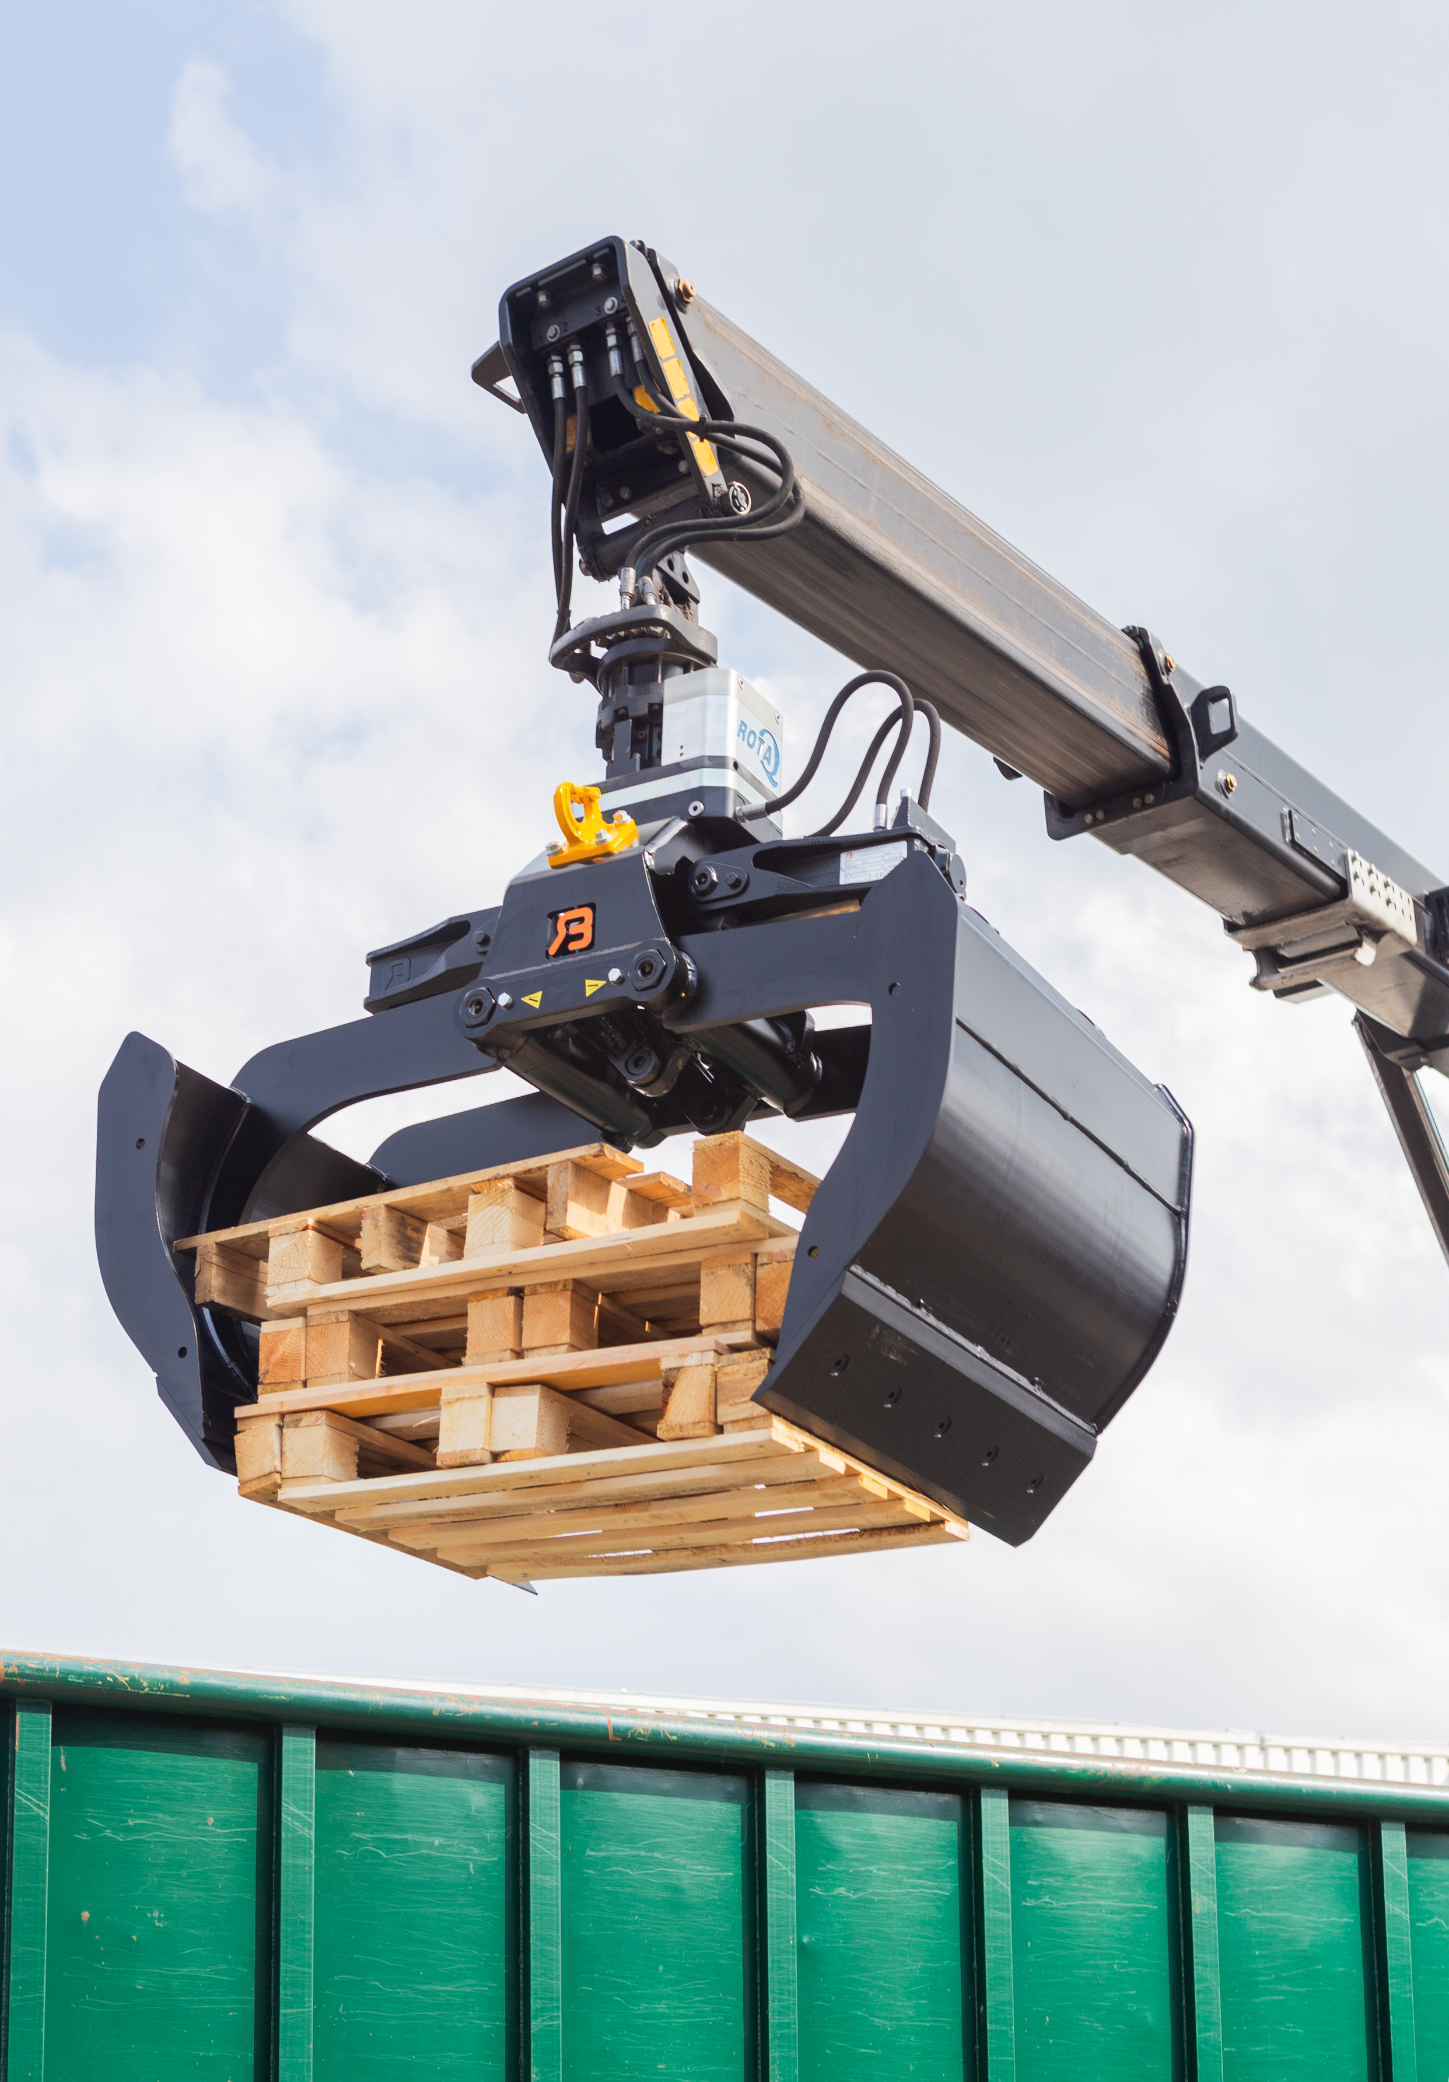
Contacts
Contact
GUSELLA-BAKKER Sales BV
Nijverheidsweg 6
6662 NG Elst (GLD), The Netherlands
T. +31 481 374757
E. info@gusella-bakker.com
W. www.gusella-bakker.com

Slide 13
